Slide 1
Project presentation Computer simulations in physics
Kürti Zoltán

Slide 2
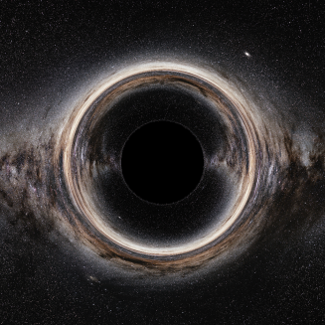
Project 1
What can we see around a black hole?
General relativity
Ray tracing (geometric optics)
https://www.eso.org/public/images/eso0932a/

Slide 3
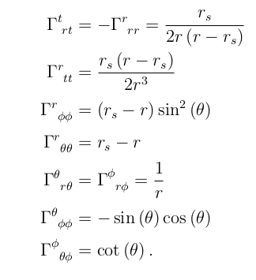
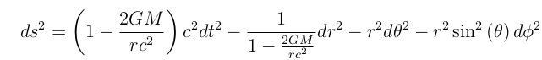
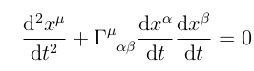
Project 1
Schwarzschild spacetime
Christoffel symbols
Geodesic equation
Numeric solution

Slide 4
Project 1
Initial conditions
Position
Just the position of the camera
Velocity
Local reference frame (set of 4 orthonormal vectors)
Parameters of the camera (field of view, resolution)
Lighlike vector corresponding to each pixel

Slide 5
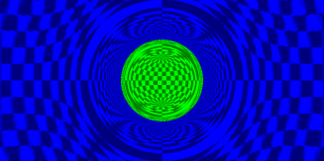
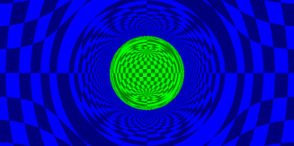
Project 1
Other details
Collision detection
Mapping to the celestial sphere
Redshift

Slide 6
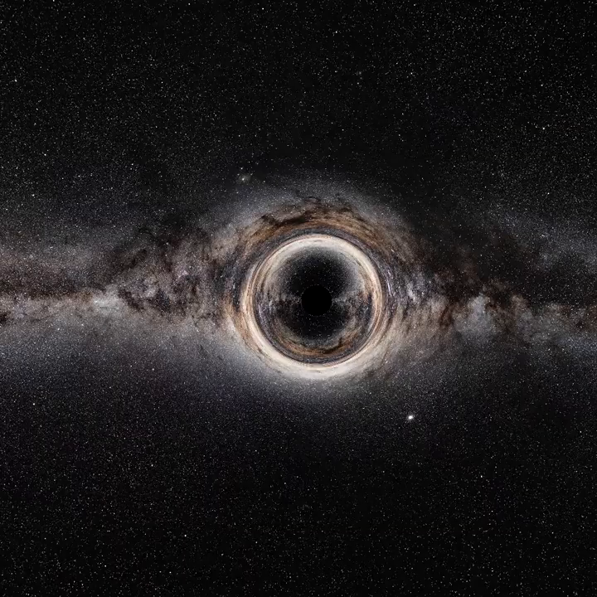
Project 1

Slide 7
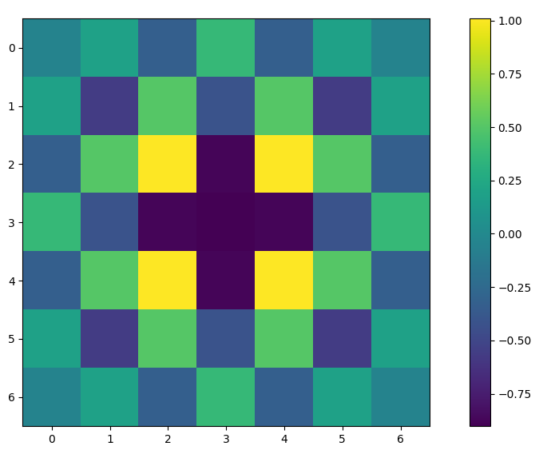
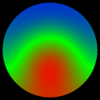
Project 2
Investigating linear PDEs (finite difference methods)
Discretized laplace operator stencils
N dimensional
Higher order
Isotropic
Bondary conditions with arbitrary geometry

Slide 8
Project 2
Obtaining the stencils
Taylor expand
Linear equations for stencil coefficients
Affine subspace
Restrict solutions with extra conditions
Isotropy (leading order error is spherically symmetric)
Works for arbitrary discretization, not just regular ones!

Slide 9
Project 2
Boundary conditions
Update the inner points according to the differential equation
Update the boundary points according to the boundary conditions (average for Neumann, set to constant for Dirichlet)
Two birds with one stone!
Laplacian can only be evaluated for inner points
Respects boundary conditions (also easily generalizes to complicated boundary conditions)

Slide 10

Project 2

